Slide 1
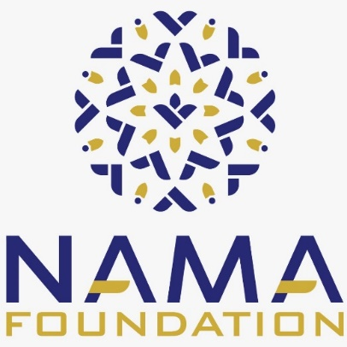
"The Market Potential of Halal in East Africa and the Opportunity to growth of Islamic Finance"
Seleman Abdallah
Program management consultant
LEAD AMBASSADOR -HALAL

Slide 2
HALAL CONCEPT
Halal is an Arabic word meaning lawful and permitted.
This halal concept comes from the holy Quran which it uses to describe objects and actions.
Halal consists of anything that is free from any component that Muslims are prohibited from consuming
According to shari’ah, all issues concerning halal or haram and even all disputes should be referred to Quran and Sunnah.
Halal and haram are universal terms that apply to all aspects of human life whether is related to his ibadat or muamalat or mua’sharah.
Halal may be defined as an act, object or conduct over which the individual has freedom of choice and its exercise does not carry either a reward or a punishment.

Slide 3
There are reasons why the halal industry is important to world’s growth as a multi racial society.
Many Muslims and non Muslims consumers still do not understand the spirit of Shariah governing these products.
Halal principles are not confined to the strictly religious, but involve health, cleanliness and safety
There is now growing awareness of the concept of Halalan-twaiban – which calls for Shariah compliance to be assessed throughout the entire supply chain of the products including distribution, marketing, and financing.

Slide 4
Financial Management in the Halal Industry: “Opportunities for Islamic finance to gain market share”
In order to achieve the spirit of a holistic halal economy that is ethical and sustainable, it is essential to ensure that shariah compliance prevails in the entire product/service supply chain of an organization for the brand integrity and Islamic investing purposes
Several companies whose core product is halal, for e.g. food products businesses, might be classified as non-compliant by Shariah screening bodies for investment purposes due to the presence of conventional financing in the company’s financial books.

Slide 5
GLOBAL HALAL INDUSTRY
The global halal industry is estimated to be worth around USD2.3 trillion (excluding islamic finance).
Growing at an estimated annual rate of 20%, the industry is valued at about USD560 billion a year.
Thus, making it one of the fastest growing consumer segments in the world.
The global halal market of 1.8 billion muslims is no longer confined to food, drinks and food related products.
The halal industry has now expanded beyond the food sector to include pharmaceuticals, cosmetics, health products, toiletries and medical devices as well as service sector components such as logistics, marketing, print and electronic media, packaging, branding, and financing.
(Fleishman hillard majlis 2011, dar, azmi et al. 2013)

Slide 6
AND DRINKS
AND TOURISM
AND ENTERTAINMENT

Slide 7
Global Islamic finance
The global Islamic FINANCE market covers different aspects, like Islamic Banking, Takaful: Islamic Insurance, Sukuk: Islamic Bonds, and Shariah Capital Market: Islamic funds.

Slide 8
According to Global Islamic Finance Markets Report 2019:
Islamic Banking is the Largest Sector, Contributing to 71%, or USD 1.72 Trillion
March 20, 2019 12:17 ET | Source: Research and Markets
Halal economy is the combination of Islamic finance and Halal industries.
This is because the values and the principles lies within the industries are similar. i.e. based from Holy Quran, Ahadeeth (Sayings of the Prophet Muhammad PBUH), Ijma’ (Consensus of Muslim scholars), Qiyas (Analogy) and Ijtihad (Logical reasoning).

Slide 9
WHAT ISLAMIC FINANCE CAN OFFER..
Islamic finance offers a variety of solutions through use of wide-range Islamic finance concepts such as sales based, leasing, profit sharing or partnership and many more that enables better fit for businesses’ need
Islamic banking is the largest sector in the Islamic finance industry, contributing to 71%, or USD 1.72 trillion, of the industry's assets.
The sector is supported by an array of commercial, wholesale, and other types of banks. Yet commercial banking remains the main contributor to the sector's growth.

Slide 10
Halal and Islamic finance industry as reported by world halal forum 2011 to be the two fastest developing Shariah-compliant trades with a yearly growth rate at 15 percent to 20 percent.
In order to become a right Halal business operator, company must focus on adopting HALAL FINANCE, not just only focusing on halal production (jaafar & musa 2013).
Based on the halal world conference 2015, the discussion on the opportunities of the integration by including financial services as part of the entire value chains of business activities is still at lower stage.

Slide 11
The global Islamic finance market is growing moderately, because of the strong investments in the halal sectors, infrastructure, and sukuk bonds, especially through electronic modes in all products and services.
The factors driving the growth of the market are directing investment toward the tremendous growth opportunities in the promising Islamic sectors.

Slide 13
For Halal industries, Shariah-compliant financing completes their operational integrity and unlocks new sources of ethical and economically viable funding.
For Islamic finance, Shariah-compliant companies get enlisted on the ethical indices series which are widely sought after as alternative asset classes for investments in the world markets.

Slide 14
Halal ----Islamic finance
The Halal industry moves about 2.2 trillion dollars of a wide range of economic activities, such as: Food and Drinks, Fashion and Modest, Pharmaceuticals and Medication, Cosmetics, Travel and Tourism, and media and recreation [1].
Halal tourism (HT) is one of the fastest-growing sectors, as reflected by the forecast of Mastercard-crescentrating [2], which predicts that Muslims will spend about 300 billion dollars by 2026.
At the same time, the Islamic financial services board [3] has estimated Islamic finance assets to be around 2.19 trillion dollars, representing less than 1% of financial assets worldwide.

Slide 15
Example of hotel
Crescent rating :
defined shariah compliant hotel as hotels where services offered and financial transactions are based on completely shariah principles, not only limited to serving halal food and beverages but also for health, safety, environment and the benefits on economic aspects of all people, despite any race, faith or culture.
Shariah Compliant hotel consists of 16 Features and attributes …..
……………….Hotel financed through Islamic Financial arrangement and Hotel should follow the Zakat principles. (Giving back to the community)

Slide 16
South Africa in like fashion has positioned itself to be a halal tourism hub and attraction despite having about 2% of Muslims constituting its total population.
We East Africa we have more than opportunities than South Africa but where are we?. We are hub for Tourism
The Halal travel market continues to "grow rapidly and evolve in a changing market", explains the global Muslim travel index report. Halal tourism market is expected to reach $300 billion by 2026.

Slide 18
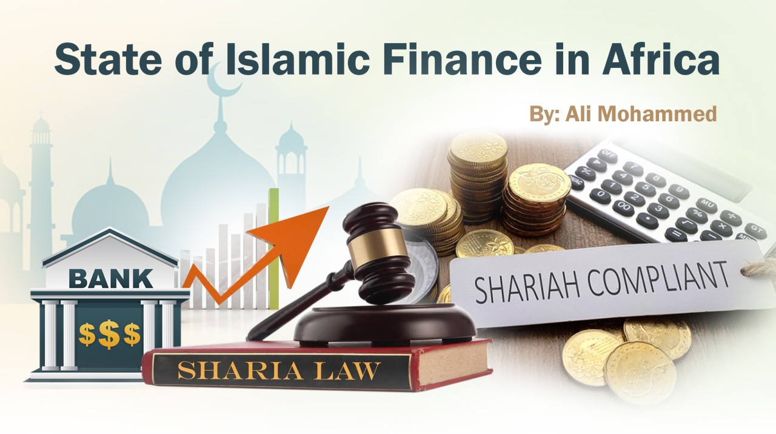
Companies whose core product is Halal, for e.g. Food products businesses, might be classified as non-compliant by shariah screening bodies for investment purposes due to the presence of conventional financing in the company’s financial books

Slide 20
Integrating Halal Industry with Islamic Funding: Where Are We Now?
Integrating Islamic funding with Halal industry is viewed as a way to increase consumers’ confidence on halal products and services as well as to boost up the halal businesses, Islamic Banking and Islamic Finance .
One of its approach is by channeling the Islamic funds from Islamic Capital market instruments (ie. Equity and Sukuk).
For example, businesses who wish to acquire equipment or commercial vehicles can explore Ijarah contract, which allows businesses to lease equipment or commercial vehicles from an Islamic bank on rental for the usage of equipment during the lease period.

Slide 21
The question is, how far the integration is adopted in the Halal industry?

Slide 22
Financial inclusion in sub-Saharan Africa

Slide 23
Given the mutually beneficial relationship between the halal industry and Islamic finance, Islamic financial institutions are presented with an opportunity to target companies in the halal sector and provide them with sharia compliant financial solutions which can further expand the asset base and outreach of the global Islamic finance industry.

Slide 24
Companies in the halal industry, like any other business, have various financial needs including
trade finance,
risk management / hedging products,
capital expenditure funds,
liquidity management,
working capital needs,
and other corporate financial solutions.

Slide 25
HALAL INDUSTRY FINANCIAL NEED
TRADE FINANCING
CAPITAL INVESTMENT &WORKING CAPITAL
RISK MANAGEMENT AND HEDGING PRODUCT
LIQUIDIT MANAGEMENT FOR FINANCIAL INSTITUTION

Slide 26
In this regard, Islamic financial institutions have a promising opportunity to encourage companies, whose core businesses are halal, to utilize Islamic financing facilities and achieve a wholly shariah-compliant status.

Slide 27
Islamic finance is an obvious conduit for channeling surplus funds into productive investments found throughout the value chain within the halal economy
Support the promotion and awareness of the Halal Concept and opportunity as it has the legal and enforcement driving force and humanitarian benefits
The relationship between Islamic finance and halal industries is mutually beneficial

Slide 28
THANKS
SELEMAN ABDALLAH -
AMC, SMA,MPM,BAPPMCD
PROJECT MANAGEMENT –CONSULTANT
NICE TANZANIA
BOX 100035 DARESSALAAM
program@nicetanzania.co.tz
www.nicetanzania.co.tz
+255712008227

